Slide 1

NGO-ISAC
Best Practices on Updating and Configuring Systems
https://www.ngoisac.org/ membership@ngoisac.org

Slide 2
Mission Description
This mission involves providing advice on best practices for updating and configuring both physical and digital systems.
The specific systems requiring assistance are identified through further discussions. Who: operational staff with administrative or decision making roles

Slide 3
Related Missions
Assets Inventory Development-The purpose of this mission is to assist the Beneficiary NGO in developing an inventory of their assets. This includes identifying and documenting all the hardware, software, and digital resources used within the organization. Having a comprehensive inventory helps in understanding the organization's technology landscape, identifying potential vulnerabilities, and implementing appropriate security measures.
Cloud Services Mapping- In this mission, the Builders provide support in mapping the Beneficiary's cloud service providers. The objective is to gain visibility and understanding of the organization's cloud-based services, including Infrastructure-as-a-Service (IaaS), Platform-as-a-Service (PaaS), and Software-as-a-Service (SaaS). By mapping cloud services, the organization can better manage and secure their cloud-based assets and data.

Slide 4
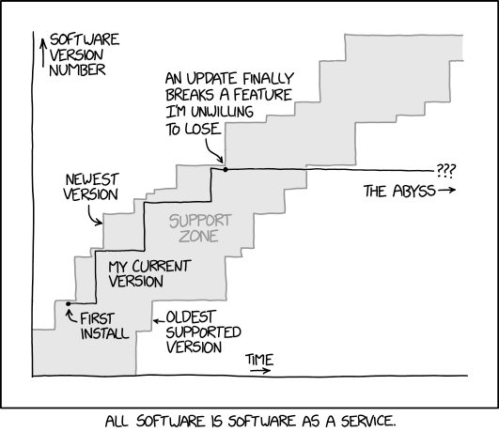
Definitions
Risk – ”A measure of the extent to which an entity is threatened by a potential circumstance or event, and typically a function of: (i) the adverse impacts that would arise if the circumstance or event occurs; and (ii) the likelihood of occurrence.” – NIST
Updates (Patches) – software changes to systems to fix functionality or security issues after release
Mobile Device Management – (MDM) method to manage mobile devices
Secure by Default/Design – Signatory companies attempt to make systems secure with minimum user effort **

Slide 5
Definitions
Risk – ”A measure of the extent to which an entity is threatened by a potential circumstance or event, and typically a function of: (i) the adverse impacts that would arise if the circumstance or event occurs; and (ii) the likelihood of occurrence.” – NIST
Patches – software updates to systems to fix functionality or security issues
Mobile Device Management – (MDM) method to manage devices
Secure by Default/Design – A strategy where companies attempt to make their systems secure with little or no changes to the initial signon
Notes:
0patch cliff

Slide 6
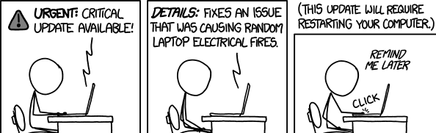
Configuration Management
Secure by Design/Default
Patch management?
What systems should you update?
How do you apply updates?
What is enterprise patch management?
What is Mobile device management (MDM)?
How to monitor what needs updating?

Slide 7

What to patch?
Operating System
Applications
Network Equipment
Mobile Devices
Printers
Smart Devices- TVs, Bulbs, Switches, DVRs, etc.
Internet of Things
Notes:
Printers are a surprisingly important part of you patch management strategy.

Slide 8
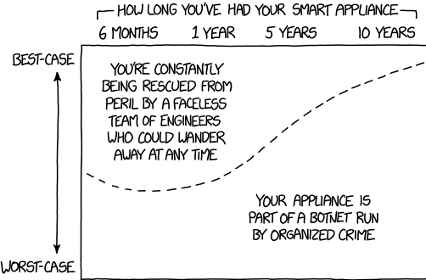
Maybe everything doesn’t have to be online?
Don’t configure them to be on the internet, you are the product
Example devices that should stay offline (probably)
TVs
Coffee makers
Refrigerators
Fitness machines Thermostats

Slide 9
Secure by Design / Secure by Default
This is a voluntary pledge that some companies agreed to.
US CISA
UK NCSC
Defaults and their effects
Security and privacy risks are related but not necessarily the same.
Venmo
RIght to Repair, related concept.
Topics from the major platform vendors
Microsoft Security Baselines
Apple Platform Security
Google Workspaces User Security Settings
Google Personal Security Checkup

Slide 10
Your services aren’t Secure By Design?
Now security assurance falls on:
HR
Managers
IT
Operations
Getting configuration dialed in is iterative. You may over secure yourself, but that’s better than undersecuring.
Windows
MS 365
Google Workspaces
Apple

Slide 11
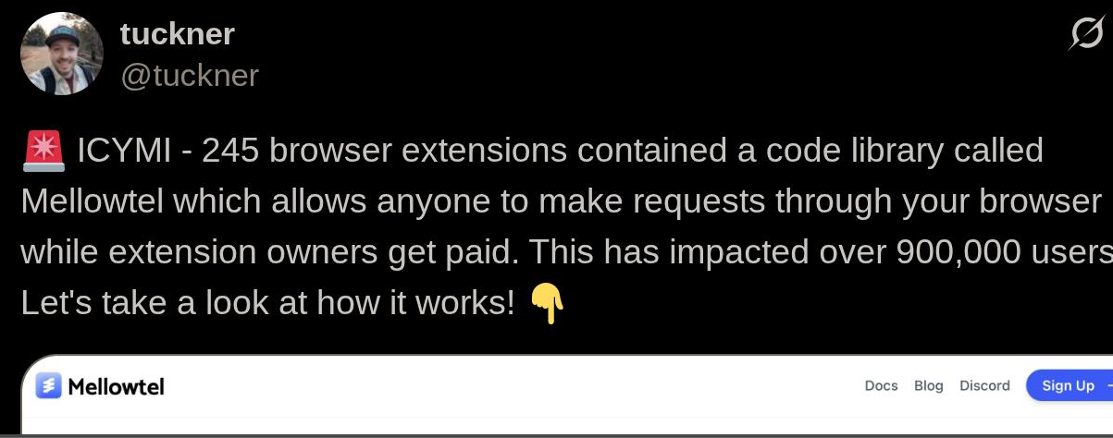
insecure by configuration: Plugins
Plugins contain custom code to defeat security policy
Browser plugins
mellowtel proxy for hire
no rules (mostly)
Wordpress
market police
VSCode/IntelliJ
ML/AI injections
crypto-scams
Auto-updates malicious?

Slide 12

Bake in observability
Log the things.
Cloudtrail (AWS)
Azure Monitor
Splunk
GCP Cloud Audit log
GAT+ ( extension )
Security Information Event Management (SIEM)
$$$
high effort
Old but good
Syslog
Sawmill
SNMP

Slide 13
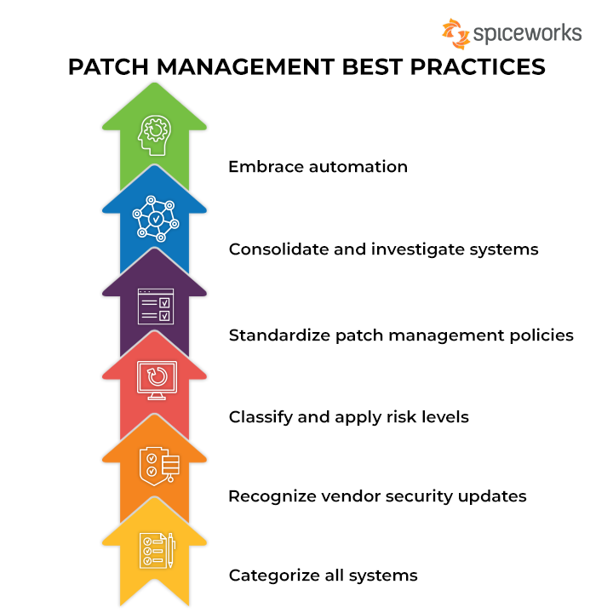
Patch Management Cycle
Asset Inventory foundational (mission #3)
Monitor vendors for updates (mission #1)
Backup / Apply Updates / Test (Can’t do this enough think $CRWD)
Repeat on all systems
https://www.spiceworks.com/tech/devops/articles/what-is-patch-management/
Notes:
What is patch management? It’s a systemic plan to keep devices up to date! It can be a spreadsheet
Asset inventory needs to be a first step, you can’t secure what you don’t know. We have a mission for that
Monitoring can be as simple as google alerts for every vendor you use w/ the word “update”
Classifying and apply risk levels … sometimes you “can’t” apply a patch, if you do this make it an exception rather than a rule and DOCUMENT that the exception has been made. Apply extra compensating controls so that any potential risks are mitigated.
This is tedious on anything more than a small handful of systems. Consider automating this with Apple Business

Slide 14
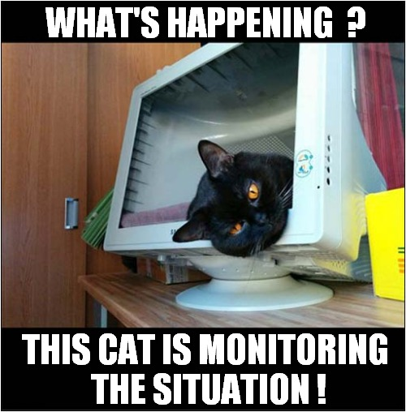
How to track what to patch?
Your vendor may not offer help early enough.
Alert sources
Google alerts
Full disclosure
Twitter
Subscribe to vendor alerts
CISA
Use automation
https://ninite.com/pro
Lansweeper
Apple Enterprise Business
JAMF

Slide 15

Non-Automated Patching
Herding cats and individually update systems
Use Google Workspace or MS 365 to verify mobile
Don’t forget
Printers
Networking Gear
Televisions
IoT or Smart Devices!
Then do it again
Next week, month, etc.
Or whenever
But don’t forget
Ever.

Slide 16

Automatic Updating
Automatic patching
Scheduled
vs. waivers
Discourage delaying updates
Enforce updates
Management agent
policy

Slide 17

End of Life (EOL)
Identify persistent storage
Disc drives
Memory cards
Soldered flash memories
tricky to wipe
External id
Asset tags
Labels
Batteries
No biohazards please
Ecycling can be done at low or no cost

Slide 18
Update Patch Lifecycle
2
2. Apply Updates
1. Identify Assets
1
3
3 . Verify updates
4. Monitor for new updates
4
Notes:
End goal have funders for area introduce NGO ISAC to grantees with benefits of collaboration clear
THANK THE AUDIENCE FOR ENABLING THIS TRANSFORMATION

Slide 19
[ Questions ? ]
Notes:
Be ready for: Constellation, Membership dues

